Slide 1


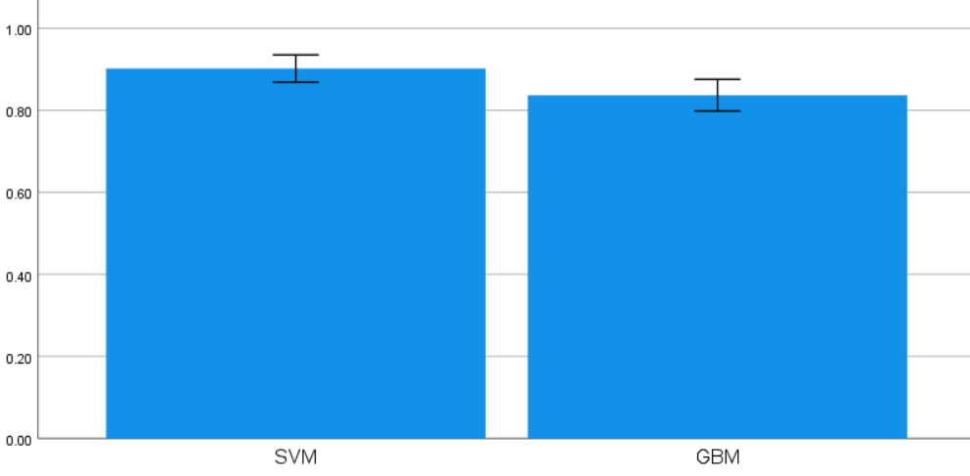
Name: N. Ashok Naidu
Register Number: 192110591
Guided by:Dr.D.Beulah David
Enhancing the Accuracy in Identifying Rice Species Using Support Vector Machine in Comparison With Gradient Boosting Machine
INTRODUCTION
The remarkable capacity of Support Vector Machines (SVMs) to capture complicated feature linkages and set exact decision boundaries makes them very valuable in the field of rice species identification. Because of this, SVMs can recognize subtle differences across species with accuracy.
SVMs have a strong emphasis on maximizing the margins between classes, which is a tactical method that aids in improving and classifying rice species with sharper distinctions. as well as the model's strong generalization to new data. Conversely, gradient boosting algorithms usually produce borders that lack subtlety.
Furthermore, SVMs show a notable ability to effectively handle overfitting issues that are commonly observed in high-dimensional datasets related to tasks involving the identification of rice species, ensuring consistent and robust performance even in complex data environments.
Fig 1 Rice species identification
MATERIALS AND METHODS
Support vector machine(SVM)model
Identify relevant features to distinguish rice species.
Optimize SVM parameters like kernel type and regularization.
Scale features to ensure SVM's robust performance.
Model Comparison
Present the results of experiments comparing the performance of SVM and GBM models.
Include tables or graphs illustrating classification accuracy and other evaluation metrics.
Data Collection
Describe the source of the dataset containing images or features of rice species.
Detail the characteristics of the dataset, including the number of samples, classes, and any preprocessing steps applied.
Data Preprocessing
Clean, transform, and scale data.
Handle class imbalance.
Split data and implement cross-validation.
Gradient boosting machine
GBM algorithms are less sensitive to feature scaling but may benefit from categorical feature encoding.
Ensure that categorical variables are appropriately encoded before training the GBM model.
Model EvaluationDefine the evaluation metrics used to assess the performance of the models, such as accuracy, precision, recall, F1-score, and area under the receiver operating characteristic curve
Justify the choice of evaluation metrics based on the problem context.
Model Integration
Train SVM and GBM models.
Compare performance metrics.
Analyze feature importance.
Address computational resources and ethical considerations.
RESULTS
Table 1. Comparison of the Accuracy values of SVM and GBM Algorithms with a Test size of 10 Samples
Table 2. Mean, Standard Deviation and Standard error mean with accuracy rate comparison of Support vector machine over Gradient boosting machine algorithm
S.No | Test Size | ACCURACY RATE
 |  | Support vector Machine Algorithm | Gradient boosting Machine Algorithm
1 | Test 1 | 92.55 | 82.36%
2 | Test 2 | 91.23 | 85.19%
3 | Test 3 | 93.78 | 81.58%
4 | est 4 | 89.67 | 87.91%
5 | Test 5 | 94.32 | 79.43%
6 | Test 6 | 90.88 | 84.65%
7 | Test 7 | 93.45 | 80.27%
8 | Test 8 | 88.76 | 86.12%
9 | Test 9 | 91.99 | 88.76%
10 | Test 10 | 91.99 | 83.09%
Average Test Results |  | 92.91 | 83.72%
 | Group | N | Mean | Std. Deviation | Std. Mean
Accuracy | SVM Algorithm | 10 | .9020 | .04662 | .01474
 | GBM algorithm | 10 | .8370 | .05417 | .01713
Fig 2: SVM and gradient boosting machine
The graph represents a visual comparison of SVM and GBM models, highlighting their respective accuracy scores for evaluation.
DISCUSSION AND CONCLUSION
Accuracy for rice species identification: 0.93, with precision and recall for "Cammeo" at 0.92 and 0.93 respectively, and for "Osmancik" at 0.94 and 0.93 respectively, supported by 762 samples.
Noisy GBM model achieved an accuracy of 0.84, with precision-recall pairs for "Cammeo" at 0.85-0.78 and for "Osmancik" at 0.83-0.89, supported by 762 samples.
Future scope involves exploring deep learning and integrating spectral imaging for enhanced accuracy in rice species identification, considering factors like data quality, environmental variability, and limitations in real-world adaptability and computational scalability.
The robust classification performance, marked by high accuracy and precision metrics, highlights the model's effectiveness in rice species identification, vital for agricultural decisions and biodiversity preservation.
BIBLIOGRAPHY
Bi, Y., Yassue, R.M., Paul, P., Dhatt, B.K., Sandhu, J., Do, P.T., Walia, H., Obata, T. and Morota, G., 2023. Evaluating metabolic and genomic data for predicting grain traits under high night temperature stress in rice. G3: Genes, Genomes, Genetics, 13(5), p.jkad052.
Chang, T.T. and Bardenas, E.A., 1965. The morphology and varietal characteristics of the rice plant (Vol. 4). Int. Rice Res. Inst.
Virmani, S.S., Mao, C.X. and Hardy, B. eds., 2003. Hybrid rice for food security, poverty alleviation, and environmental protection. Int. Rice Res. Inst.
Kumar, N., Shahnaz, C., Kumar, K., Mohammed, M. and Raw, R., 2020. Advance concepts of image processing and pattern recognition. Pattern Recognition, 4(2), pp.1-10.
Getachew, B., 2024. plant species classification using deep learning (Doctoral dissertation, St. Mary's University).

